Slide 1



Unit Conversion Program in C
Introduction to the program
Purpose: Enable users to convert units of measurement such as length, weight, volume, and temperature
Language: C

Slide 2

Code Overview
Include statement: #include <stdio.h>
Function prototypes for conversion functions
Length conversion functions: meters_to_feet, feet_to_meters
Weight conversion functions: kilograms_to_pounds, pounds_to_kilograms Weight conversion functions: kilograms_to_pounds, pounds_to_kilograms Temperature conversion functions: celsius_to_fahrenheit, fahrenheit_to_celsius

Slide 3
Main Program
displayMenu() function: Displays the main menu options
convertLength() function: Converts length units (meters to feet and vice versa)
convertWeight() function: Converts weight units (kilograms to pounds and vice versa)
convertVolume() function: Converts volume units (liters to gallons and vice versa)
convertTemperature() function: Converts temperature units (celsius to fahrenheit and vice versa)
main() function: Implements the main program logic using a do-while loop to handle user choices and calls the corresponding conversion functions

Slide 4
How to Use the Program
Step 1
Run the program
Step 2
Select the desired unit conversion option from the main menu (1-5)
Step 3
Enter the value you want to convert
Step 4
View the converted result
Step 5
Repeat the process or select the exit option (5) to end the program

Slide 5
The Unit Conversion Program is a C language program designed to provide users with a convenient way to convert units of measurement. The program supports conversions for various types of units, including length, weight, volume, and temperature. By utilizing this program, users can quickly and accurately convert measurements between different units based on their specific needs.

Slide 6
The program begins by presenting a user-friendly menu that displays the available conversion options. The menu prompts the user to choose a conversion category, such as length, weight, volume, or temperature. Once the category is selected, the program guides the user through the conversion process, allowing them to input the value they wish to convert.

Slide 7

Length conversions
For length conversions, the program provides functions to convert between meters and feet. Users can input a value in meters or feet, and the program will calculate the corresponding converted value using the appropriate conversion formula.

Slide 8

Weight conversions
Weight conversions are also supported by the program, offering conversions between kilograms and pounds. Users can input a value in kilograms or pounds, and the program will perform the necessary calculation to provide the converted value.

Slide 9

Volume conversions
Volume conversions are available for liters and gallons. The program allows users to input a value in liters or gallons and performs the conversion accordingly, ensuring accurate and efficient results.

Slide 10
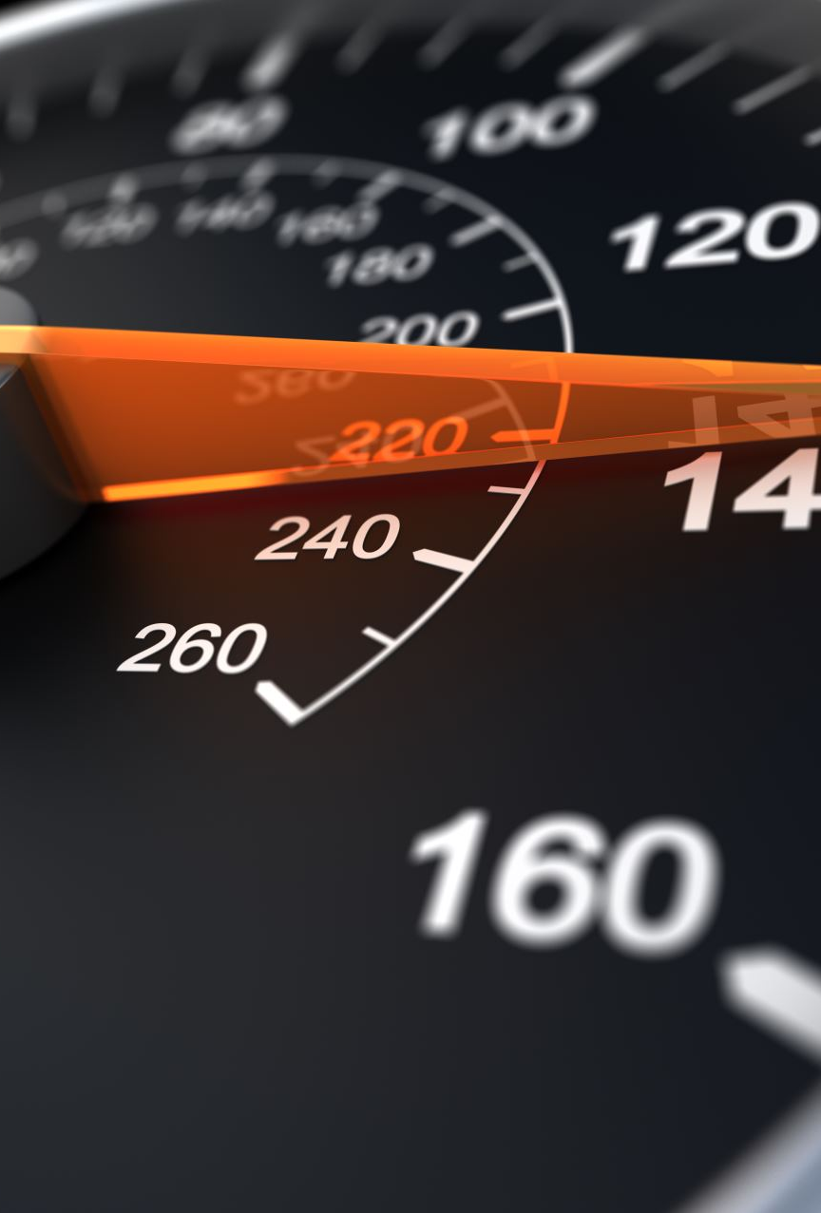
Temperature conversions
Temperature conversions are another key feature of the program. Users can convert between Celsius and Fahrenheit by providing the temperature value in either unit. The program applies the respective conversion formula to deliver the converted temperature value.

Slide 11

End
Throughout the program, user input is validated to ensure that valid choices and values are entered. In case of invalid selections or inputs, appropriate error messages are displayed, guiding the user to make the correct choices.
The program is implemented using modular functions, enabling easy maintenance and future expansion. Each conversion type has its own dedicated function, promoting code reusability and readability.
Overall, the Unit Conversion Program provides a versatile and user-friendly solution for performing unit conversions in a variety of measurement categories. With its simplicity and efficiency, users can save time and effort by utilizing this program to convert units accurately and conveniently.

